Slide 1
INVESTMENT CASE STUDY SUBMISSION
Group Name:
Ritul Patel
Varun Devayya
Prem Balakrishnan
Sneha Bhatt

Slide 2
Spark Funds – Investment Objectives
Business Objective
Invest in low-risk circles with almost assured ROIs
Trace & follow current investment pattern for initial round of investment
Invest in most ripe sector as per past trends
Guidelines for Initial phase of investment
Investment value between $5 & $15 million
Investment portfolio to be limited to Angel, Seed, Venture, Private Equity only
Countries where English is an official language
Sectors with maximum momentum for investment
Companies with maximum investment inflow

Slide 3
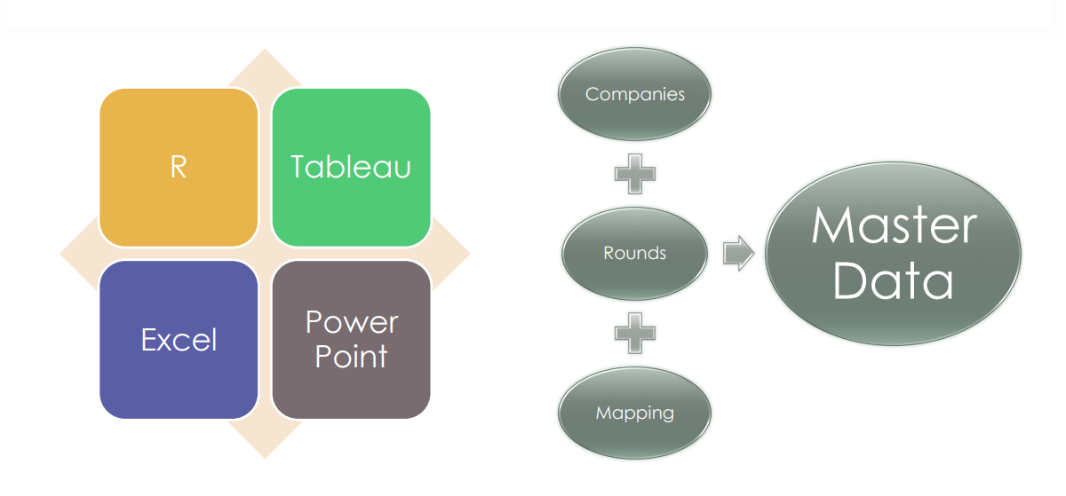
Spark Funds - Problem Solving Tools

Slide 4
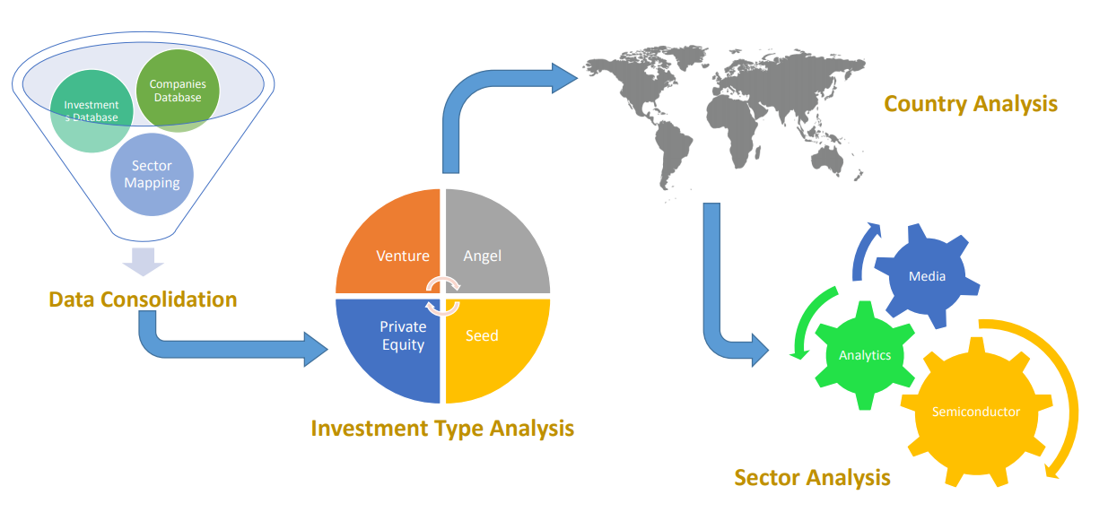
Spark Funds – Analysis Methodology

Slide 5
Investment Type Analysis
Data from a total of 66,368 unique companies were analysed
Average funding dispensed in each type of investment is shown below :
Considering that Spark Funds wants to invest between 5 to 15 million USD per investment round, venture type of investment is most suitable for them.
Average funding amount of venture type | $ 11,748,949.10
Average funding amount of angel type | $ 958,694.50
Average funding amount of seed type | $ 719,818.00
Average funding amount of private equity type | $ 73,308,593.00

Slide 6
Country Analysis
Spark Funds seeks to invest in English speaking countries where most investments are occurring for the chosen Investment Type
Analysis Step 1:
For the chosen (venture) investment type, what are the top 9 countries based on the total investment
Analysis Step 2:
Among the above top 9 countries , identify the top 3 English speaking countries.

Slide 7
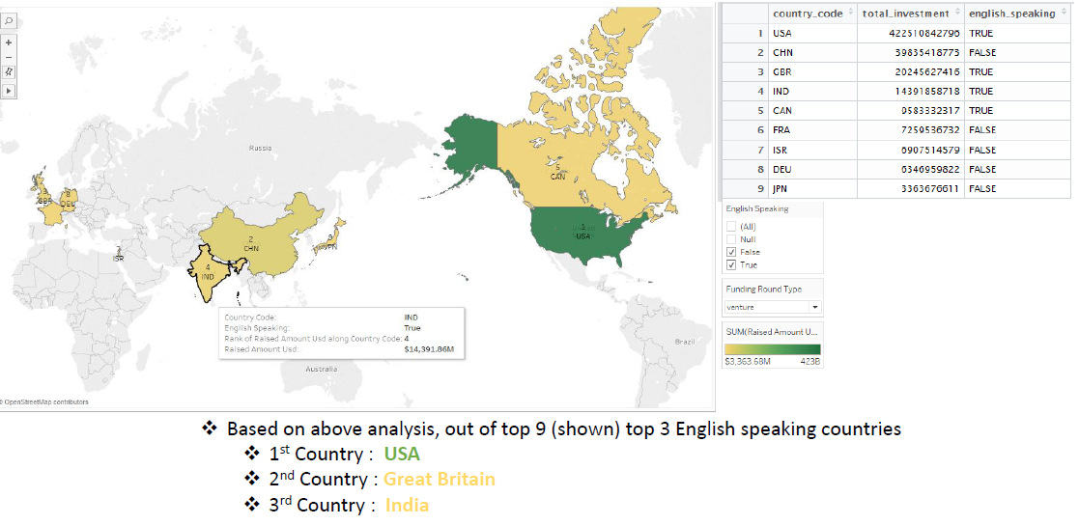
Country Analysis Results

Slide 8
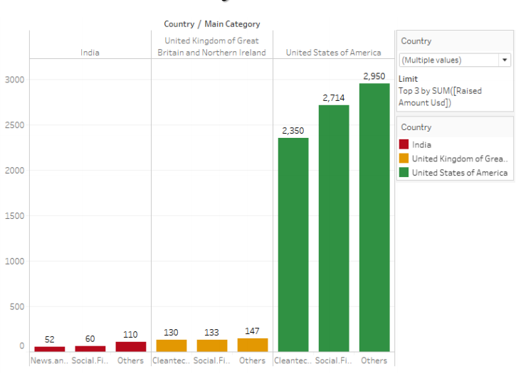
Sector Analysis
Country With Top Investment : United States
Top Sector : Others
Second Top Sector :Social, Finance, Analytics, Advertising
Third Top Sector : Cleantech / Semiconductors
Country With Second Highest Investment : United Kingdom
Top Sector :Others
Second Top Sector : Social, Finance, Analytics, Advertising
Third Top Sector : Cleantech / Semiconductors
Country With Third Highest Investment : India
Top Sector : Others
Second Top Sector : Social, Finance, Analytics, Advertising
Third Top Sector : News, Search and Messaging

Slide 9
Sector-wise Investment Analysis Result
 |  | Country 1 : USA | Country 2: GBR | Country 3: IND
1 | Total number of Investments (count) | 12150 | 628 | 330
2 | Total amount of investment (USD) | 108531347515 | 5436843539 | 2976543602
3 | Top Sector name (no. of investment-wise) | Others | Others | Others
4 | Second Sector name (no. of investment-wise) | Social, Finance, Analytics, Advertising | Social, Finance, Analytics, Advertising | Social, Finance, Analytics, Advertising
5 | Third Sector name (no. of investment-wise) | Cleantech / Semiconductors | Cleantech / Semiconductors | News, Search and Messaging
6 | Number of investments in top sector (3) | 2950 | 147 | 110
7 | Number of investments in second sector (4) | 2714 | 133 | 60
8 | Number of investments in third sector (5) | 2350 | 130 | 52
9 | For point 3 (top sector count-wise), which company received the highest investment? | /organization/virtustream | /organization/electric-cloud | /organization/firstcry-com
10 | For point 4 (second best sector count-wise), which company received the highest investment? | /organization/shotspotte | /organization/celltick-technologies | /organization/manthan-systems

Slide 10
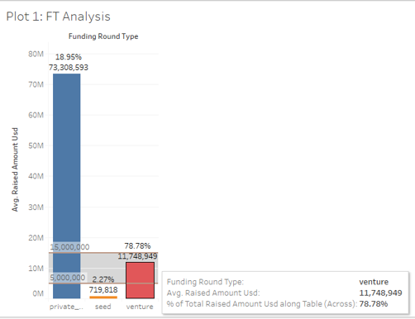

Plot 1: Funding Type Analysis
A plot showing the fraction of total investments (globally) in venture, seed, and private equity, and the average amount of investment in each funding type. This chart should make it clear that a certain funding type (FT) is best suited for Spark Funds.
As shown in graph, the tooltip added provides
Funding Round Type
Average investment of venture falls under the per round investment limit of $5m - $15m
Percentage of total investment in individual investment types.

Slide 11
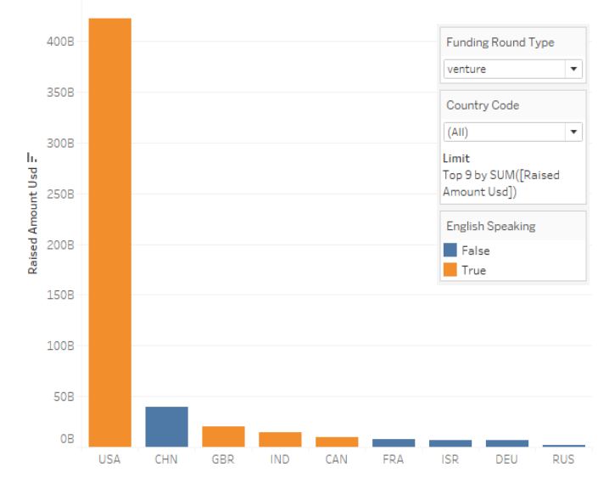
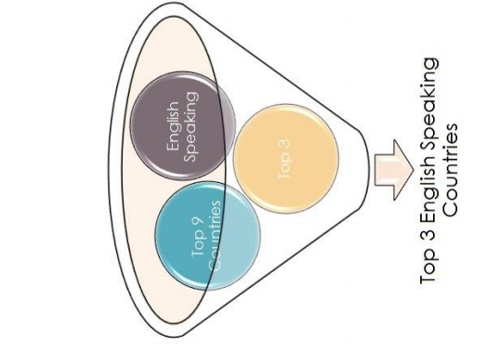
Plot 2: Country Analysis
A plot showing the top 9 countries against the total amount of investments of funding type FT. This should make the top 3 countries (Country 1, Country 2, and Country 3) very clear.

Slide 12
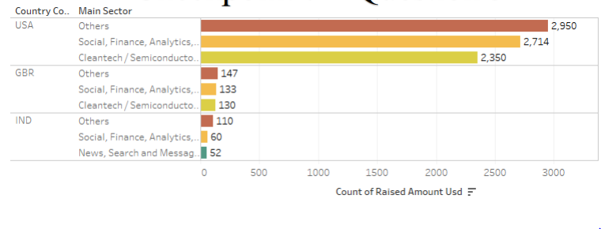
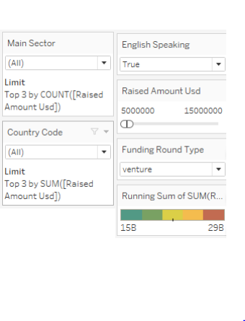
Plot 3: Sector Analysis
A plot showing the number of investments in the top 3 sectors of the top 3 countries on one chart (for the chosen investment type FT)

Slide 13
Conclusion
Best recommended type of invest for Spark Funds is
Venture
Top 3 targeted (English Speaking) countries are
United States
United Kingdom
India
Top 3 sectors of the top 3 countries are
Others
Social, Finance, Analytics, Advertising
For United States and United Kingdom : Cleantech / Semiconductors and for India : News, Search, Messaging

